Slide 1
WAN Technologies Overview
WANs generally function at Layer 1 & 2
Primarily concerned with moving data between LANs
Use leased-line, circuit-switched, and packet-switched technology
Usually capable of handling voice, video, and data simultaneously

Slide 2
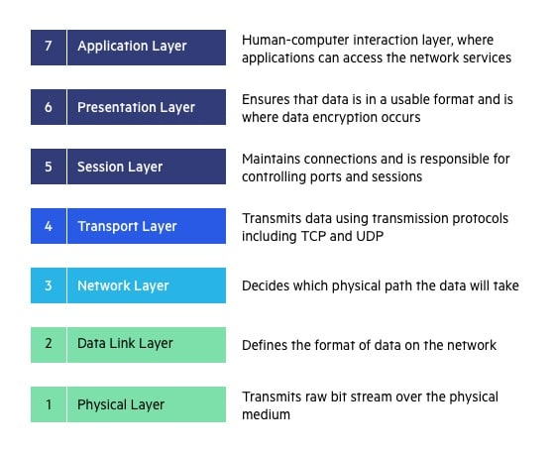
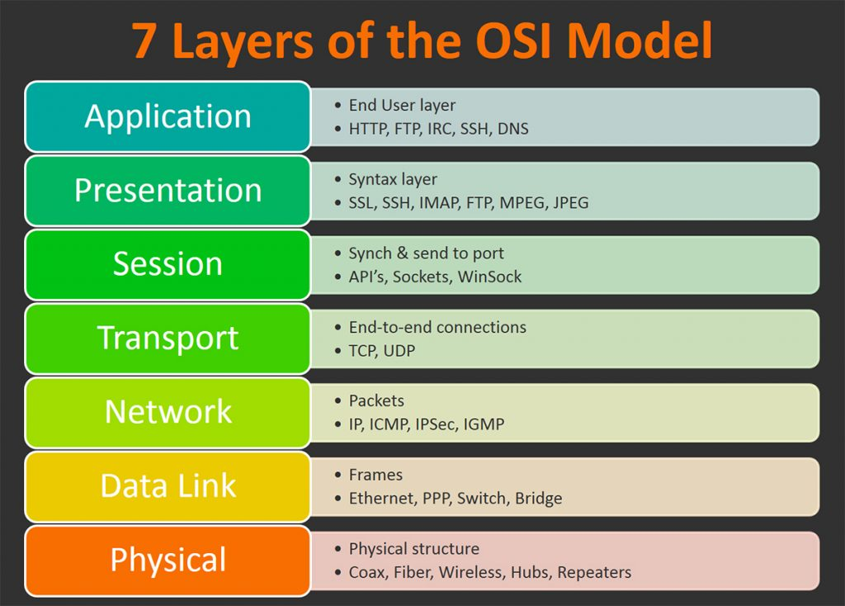
Recall OSI Network layers

Slide 3
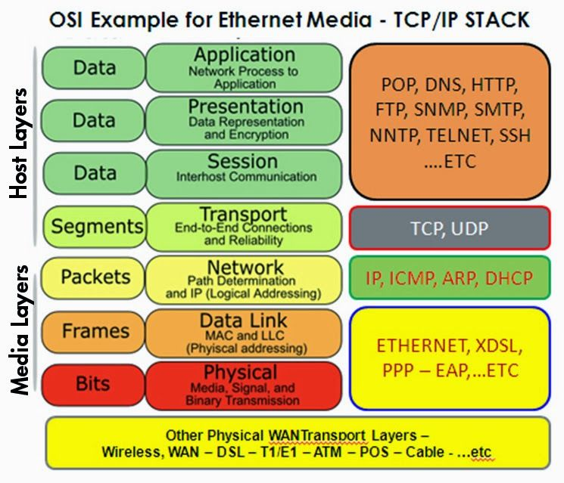
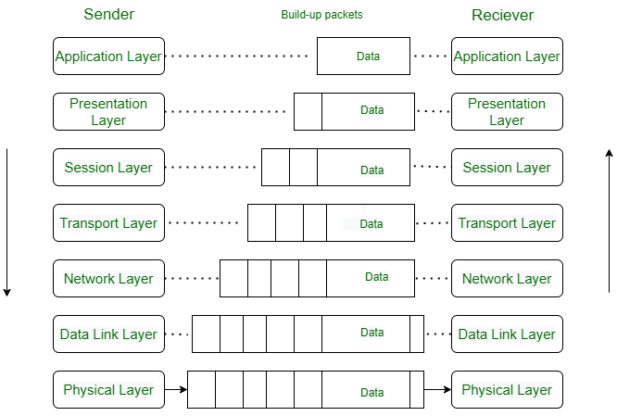
Cont…

Slide 4
WAN Technologies Overview
WAN Versus LAN
WAN carrier services are usually subscribed to by user
WAN services used for:
  Connect branches
  Access services of other networks
  Provide access to remote users

Slide 5
WAN Technologies Overview
WAN Versus LAN (cont.)
WAN typically carries multiple services between many sites
Only large organizations have own private WAN
WANs usually span large geographical area

Slide 6
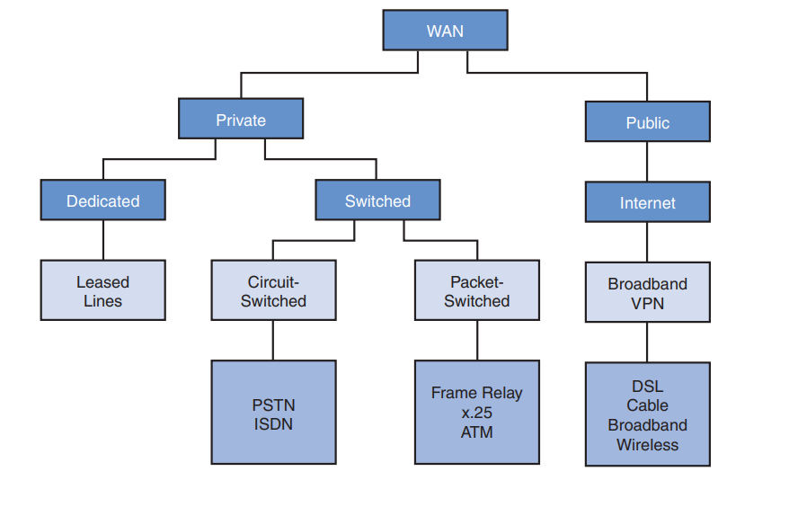
WAN ARCHITECTURE

Slide 7
WAN Technologies Overview
WAN Versus LAN (cont.)
WAN might be controlled by multiple organizations
LANs are usually high-speed connections
  Span limited geographical area
LANs usually controlled by single administrator
Difference between WANs and LANs is usually the technology involved

Slide 8
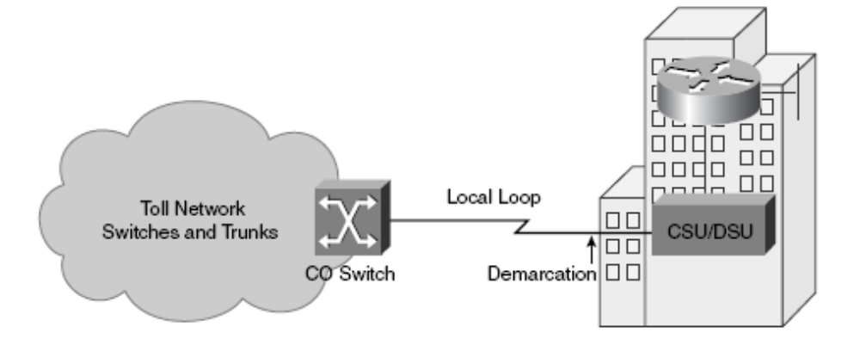
WAN Technologies Overview
WAN Versus LAN (cont.)
Customer Premises Equipment (CPE) – located at customer’s site
The CPE connects to the service provider at central office (CO)
That connection is known as local loop or “last mile”

Slide 9
WAN Technologies Overview
WAN Versus LAN (cont.)
Demarcation point (demarc) – where control is passed to WAN service provider
Data Terminal Equipment (DTE) at subscriber end passes data to
Data circuit-terminating equipment or data communications equipment (DCE)
DCE prepares data and places on local loop

Slide 10
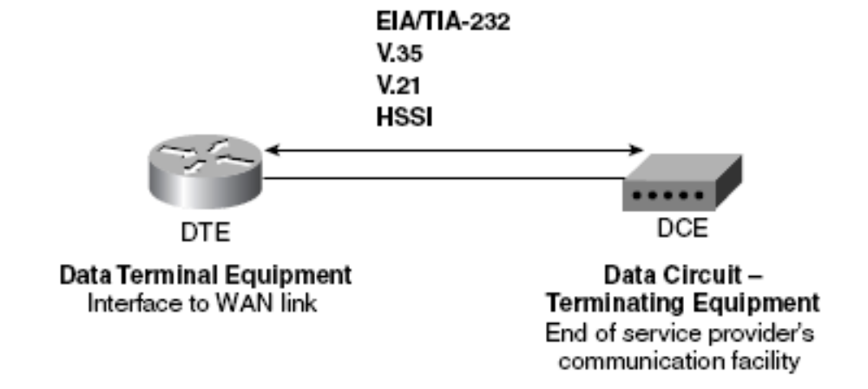
WAN Technologies Overview
WAN Versus LAN (cont.)
Various protocols are used between DCE and DTE

Slide 11
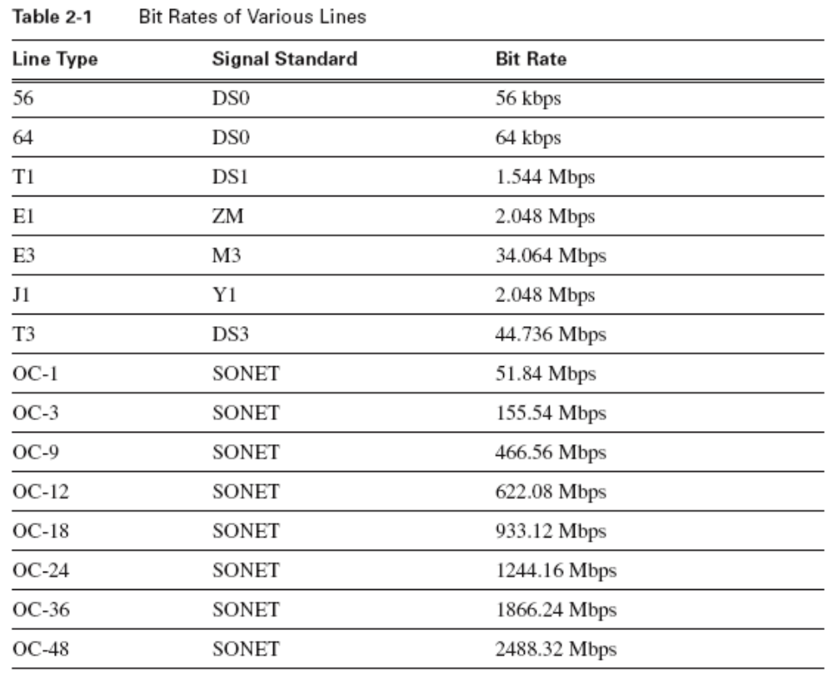
WAN Technologies Overview
WAN Versus LAN (cont.)

Slide 12
WAN Technologies Overview
WAN Versus LAN (cont.)
If the link carries analog signals like those on Public Switched Telephone Network (PSTN)
  A modem is required
If link is digital – no conversion required – formatting done by:
  Channel Service Unit (CSU)
  Data Service Unit (DSU)

Slide 13
WAN Technologies Overview
WAN Protocols
WANs primarily function at Layer 1 and 2
WAN standards include
  Physical addressing
  Flow control
  Encapsulation

Slide 14
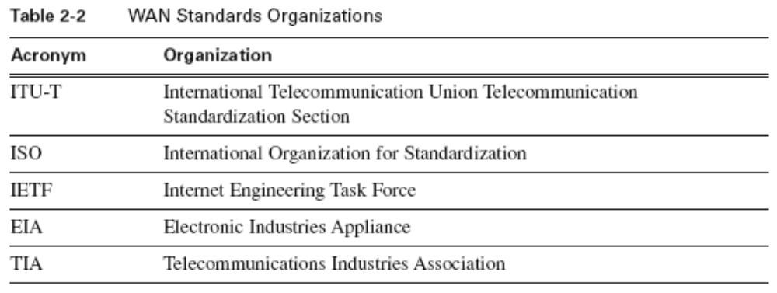
WAN Technologies Overview
WAN Protocols (cont.)
Different organizations issue WAN standards

Slide 15
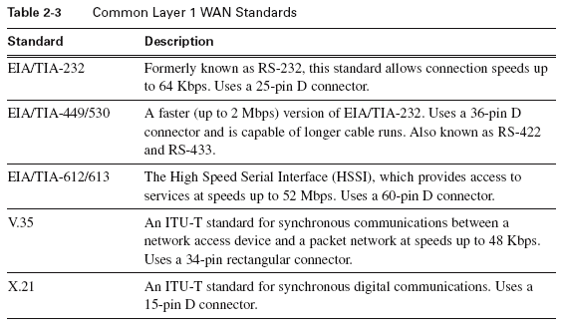
WAN Technologies Overview
WAN Protocols (cont.)
Physical layer protocols specify connections to WAN services

Slide 16
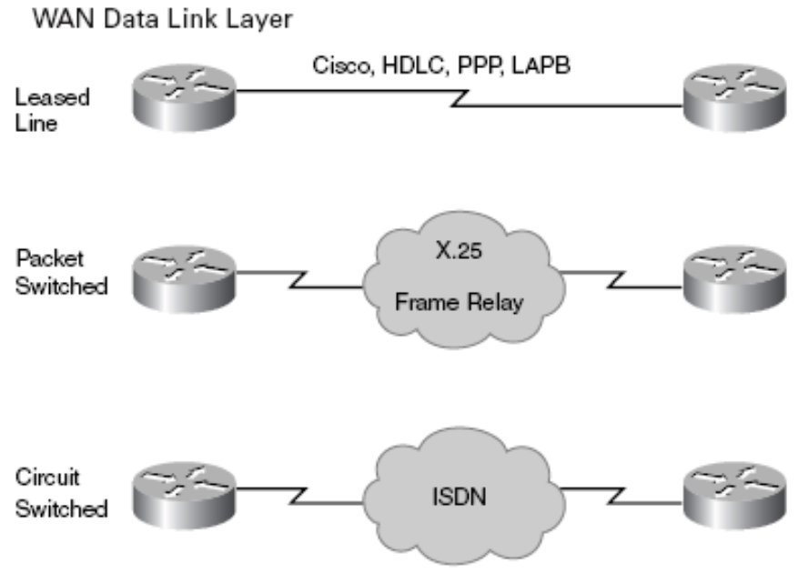
WAN Technologies Overview
WAN Protocols (cont.)
Data link layer protocols define:
  Data encapsulation
  How transportation takes place

Slide 17
WAN Technologies Overview
WAN Protocols (cont.)
Network layer data encapsulated into frames at data link layer
Type of encapsulation
  Type of technology deployed on link
  Must be configured on serial port
Most layer 2 encapsulations are a form of ISO standard High level Data Link Control (HDLC)

Slide 18
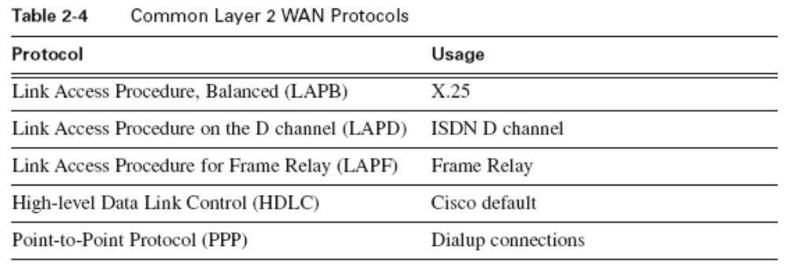
WAN Technologies Overview
WAN Protocols (cont.)
Examples of common WAN data link layer protocols

Slide 19
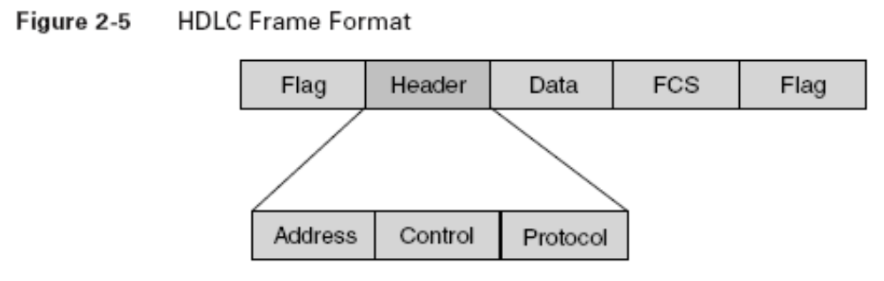
WAN Technologies Overview
WAN Protocols (cont.)
Flag fields indicate start and end of frame
Address field – in point to point not required
Control field – 1 or 2 bytes long

Slide 20
WAN Technologies Overview
WAN Protocols (cont.)
Control field indicates type of frame
  Unnumbered frames carry line setup information
  Information frames carry network layer data
  Supervisory frames control flow and do error retransmission requests

Slide 21
WAN Technologies Overview
WAN Protocols (cont.)
Protocol field is found only in PPP and Cisco HDLC
Data field followed by frame check sequence (FCS)
Uses cyclic redundancy check (CRC) to verify frame integrity

Slide 22
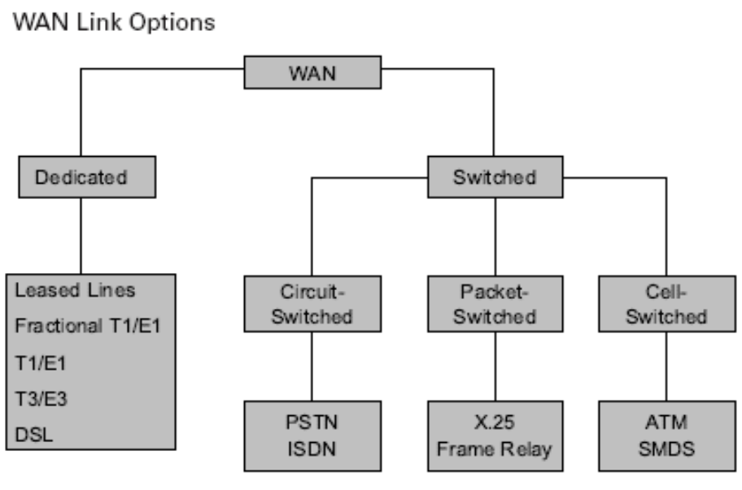
WAN Technologies Overview
Leased Line, Circuit Switching, Packet Switching
Many WAN link options
  Dedicated lines
  Switched technologies

Slide 23
WAN Technologies Overview
Leased Line, Circuit Switching, Packet Switching
Switched networks
  Circuit-switched
  Packet-switched
  Cell-switched

Slide 24
WAN Technologies Overview
Leased Line, Circuit Switching, Packet Switching
WAN Technologies
  Connection-oriented
  Connectionless

Slide 25
WAN Technologies Overview
Leased Line, Circuit Switching, Packet Switching
Each technology handles data differently
Each technology introduces amounts of delay and jitter
Delay or latency – caused when device processes the frame before sending
Jitter – variation in delay of received packets
Some traffic types (voice) are very sensitive to delay and jitter

Slide 26
WAN Technologies Overview
Leased Line, Circuit Switching, Packet Switching
Circuit-Switched Networks
  Most common example is public switched telephone network (PSTN)
  Integrated Services Digital Network (ISDN) also common example
  ISDN is digital end-to-end
  Plain Old Telephone Service (POTS) is analog and requires a modem
  Delay in building the switched circuit at setup

Slide 27
WAN Technologies Overview
Leased Line, Circuit Switching, Packet Switching
Leased-line Networks
  If setup delay unacceptable
  Use a dedicated connection from service provider
  In North America commonly T1 or T3 lines
  In the EU commonly E1 or E3
  Pricing based on bandwidth and length
  Must pay for the bandwidth if underused
  Time-division multiplexing (TDM) can divide the circuit for efficiency

Slide 28
WAN Technologies Overview
Leased Line, Circuit Switching, Packet Switching
Packet-switched Networks
  Alternative to circuit-switched technology
  Bits are turned into packets, frames, or cells
  The path of the packets is determined by addressing information on each packet
  Can be connectionless (Internet)
  Can be connection-oriented (Frame Relay)
    Path is predetermined – packets carry path information
    Path identifier in Frame Relay is Data-Link Connection Identifier (DLCI)

Slide 29
WAN Technologies Overview
Leased Line, Circuit Switching, Packet Switching
Packet Switched circuits only exist while packet travel through them
Circuits are called virtual circuits (VCs)
Two types of VCs
  Switched Virtual Circuits (SVC) – request sent through network to establish path – eventually dissolved
  Permanent Virtual Circuit (PVC) – switch set up at boot time. Always available for data transfer. Usually on Frame Relay

Slide 30
WAN Technologies Overview
WAN Technologies
Many different technologies used in WAN
  Each type is useful for specific types of data
  Each type has limits in usefulness for other types of data

Slide 31
WAN Technologies
Analog Dialup
Analog dialup useful for intermittent, low-volume transmissions
Mobile workforce needs are met
Failover if main WAN connection fails
Still deployed for access to network devices

Slide 32
WAN Technologies
Analog Dialup (cont.)
Analog dialup benefits:
  Low cost
  High availability
  Simple implementation
Analog dialup drawbacks:
  Requires a modem
  Low bit rate means long connect time for large amounts of data

Slide 33
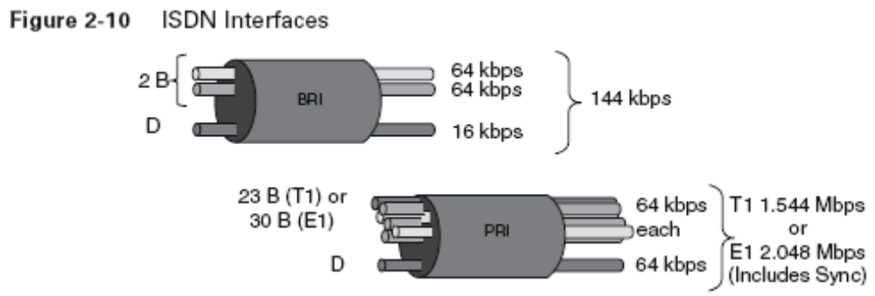
WAN Technologies
ISDN
Integrated Services Digital Network (ISDN)
Provides dedicated circuit-switched circuit
Eliminates latency and jitter
Runs on local loop

Slide 34
WAN Technologies
ISDN (cont.)
Uses bearer or B channels for data
Uses delta or D channels for control information

Slide 35
WAN Technologies
ISDN (cont.)
Basic Rate Interface (BRI)
2 – 64-kbps B channels
1 – 16-kbps D channel

Slide 36
WAN Technologies
ISDN (cont.)
Primary Rate Interface (PRI) (In North America)
23 – 64-kbps B channels
1 – 64-kbps D channel

Slide 37
WAN Technologies
ISDN (cont.)
Primary Rate Interface (PRI) (Europe/Others)
30 – 64-kbps B channels
1 – 64-kbps D channel

Slide 38
WAN Technologies
ISDN (cont.)
B channels can be used individually or in combination
The use of out-of-band signaling allows call setup of less than one second
In PRI multiple B channels can be joined to multiply bandwidth

Slide 39
WAN Technologies
ISDN (cont.)
Available in most world locations
Including rural and underdeveloped areas
Bandwidth on demand to supplement other technologies
Failover service for main WAN connection

Slide 40
WAN Technologies
Leased Line
A purchased connection from service provider
Dedicated point-to-point
Connection speeds up to 2.5 Gbps
Cost determined by bandwidth and distance
No jitter or latency

Slide 41
WAN Technologies
Leased Line (Cont.)
Required serial port on routers at each end
CSU/DSU required to connect to provider
Most purchased bandwidth goes unused
Used to connect remote site to service provider’s packet-switched network

Slide 42
WAN Technologies
X.25
First packet-switched technology was X.25 group of protocols
Introduced to mitigate high cost of leased-lines
X.25 is low bit rate network layer technology
Uses either SVCs or PVCs

Slide 43
WAN Technologies
X.25 (cont.)
Virtual circuits constructed using call request packets
SVC are assigned a channel number
Packets with the channel number are moved through network.
Cost is lower than either leased-line or circuit-switched

Slide 44
WAN Technologies
X.25 (cont.)
Costs usually based on amount of data transferred
Slow bit rate – 48kbps
High latency due to shared network
X.25 not common in North America
Many world countries have investment in it and still use it

Slide 45
WAN Technologies
Frame Relay
Frame Relay – simpler than X.25 and functions at the data link layer
Provides benefits of packet-switched network with higher transmission speeds
Most run at less than T-1 speeds – some available at DS-3 speed (45 Mbps)

Slide 46
WAN Technologies
Frame Relay (cont.)
Reduces latency by eliminating error checking and flow control
Ideal for voice, video, and data
Normally accessed through leased lines or dialup connections from end user
PVCs usually created but sometimes SVCs

Slide 47
WAN Technologies
Frame Relay (cont.)
Can use single interface on router to handle multiple VCs
Sold on basis of Committed Information Rate (CIR)
Subscriber is allowed to exceed in bursts but at extra cost and potential data loss

Slide 48
WAN Technologies
ATM
Asynchronous Transfer Mode (ATM) – developed problem with voice and video over shared-bandwidth networks
Speed in excess of 155Mbps
Very little latency or jitter introduced
Uses small fixed-length cells instead of big frames

Slide 49
WAN Technologies
ATM (cont.)
ATM cell is 53 bytes
Good for traffic sensitive to delay
Requires 20 percent more bandwidth to move same data as Frame relay
Usually deployed over PVCs
Deployment very similar to Frame Relay deployment

Slide 50
WAN Technologies
DSL
DSL uses unused bandwidth in copper lines
Broadband signals at frequencies above 4kHZ
Collectively known as xDSL
Either symmetric or asymmetric
Symmetric is same upload and download

Slide 51
WAN Technologies
DSL (cont.)
Asymmetric DSL has higher download speed than upload speed
Different forms of DSL
  Asymmetric DSL (ADSL)
  Symmetric DSL (SDSL)
  High Bit Rate (HDSL)
  ISDN (like DSL) (IDSL)
  Consumer DSL (CDSL)

Slide 52
WAN Technologies
DSL (cont.)
ADSL is most commonly found in North America
Unacceptable for hosting servers due to lower upload speed
Consumer DSL also known as G.Lite or DSL-lite

Slide 53
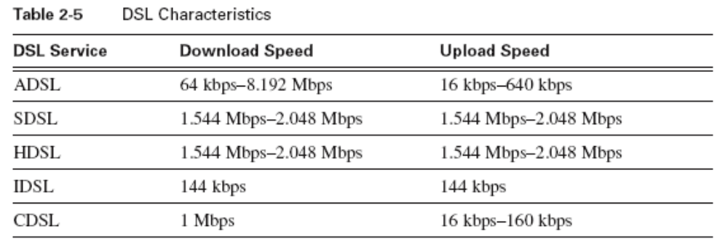
WAN Technologies
DSL (cont.)
DSL data rates available up to 8.192 Mbps

Slide 54
WAN Technologies
DSL (cont.)
Each user has dedicated connection to provider network
Multiple DSL lines are multiplexed at service provider into single line
Accomplished by use of DSL Access Multiplexer (DSLAM)

Slide 55
WAN Technologies
DSL (cont.)
Using above 4-kHz allow telephone service and DSL to run at same time
Exception is SDSL
DSL subscriber must be within 5.5 km (3.5 miles) from central office (CO)
Not commonly used to directly connect to remote network

Slide 56
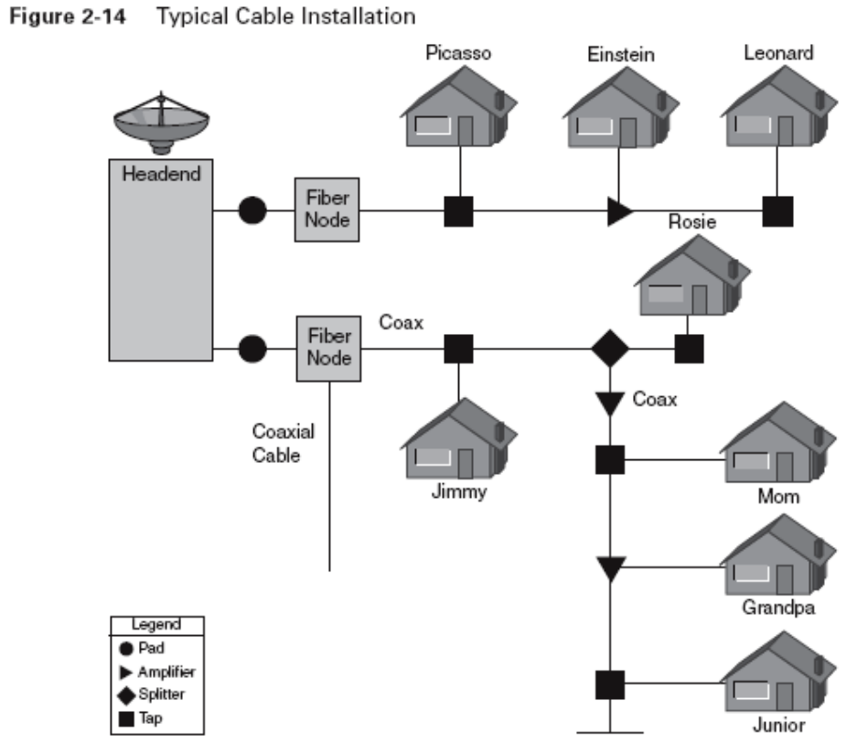
WAN Technologies
Cable
Always on connection (like DSL)
Symmetrical bandwidth
Single channel speeds up to 40 Mbps
Shared-bandwidth connection

Slide 57
WAN Technologies
Cable (cont.)
Actual data rate can depend on number of other users on same medium
Many service providers throttle bandwidth to guarantee bandwidth
For connection to a remote network a VPN should be used
Cable can also carry voice over IP (VoIP)

Slide 58
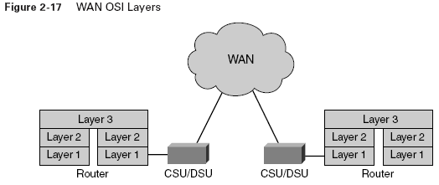
WAN Design
WAN Communication
WANs are considered a collection of data links
The data links interconnect LANs
WANs function at lower layers of OSI model

Slide 59
WAN Design
WAN Communication (cont.)
Data links usually owned by service provider
Service provider for a fee
Fees for links are a major cost part of a WAN
Data links terminate at routers
Routers can implement quality of service (QOS) to prioritize different data streams

Slide 60
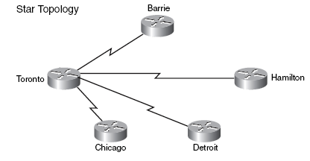
WAN Design
Identifying/Selecting Networking Capabilities
Most WANs deploy a classic star topology
Minimizes the number of circuits
No redundant links

Slide 61
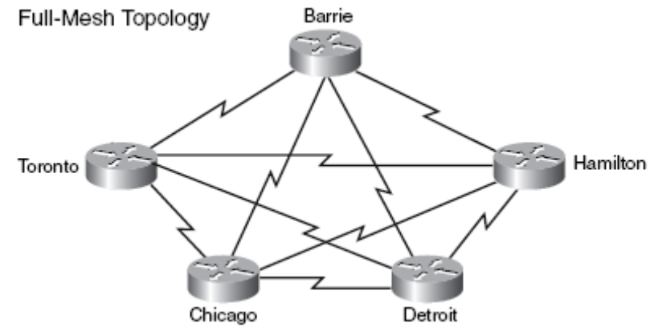
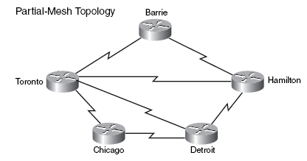
WAN Design
Identifying/Selecting Networking Capabilities (cont.)
Use of full- or partial-mesh topology creates redundant links
Adds to cost of deployment

Slide 62
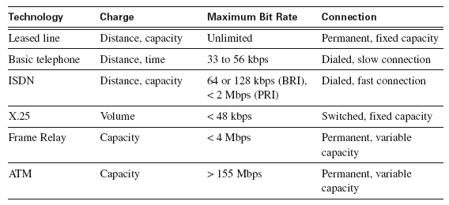
WAN Design
Identifying/Selecting Networking Capabilities (cont.)
Characteristics of common WAN technologies

